Slide 1



Team Details & Project Overview
Team Name: UlipsuGenAI
Team Leader: Vishnu Murti Choudhary
Problem Statement: DiscoverU : Dual-Perspective AI Situational Assessment Platform
Target Personas: Currently Built For: Students (Freshers) & Working Professionals (Scalable for Recruiters)
Tagline: Make Your Next Move Count

Slide 2
Brief About The Idea : DiscoverU
Persona-Driven AI Situational Assessment Built for Freshers & Professionals (Scalable for Recruiters)
1. Student (Fresher) Track
Target Audience: College graduates, entry-level candidates, and early-career job seekers.
Methodology: 16 targeted option-based questions combining MBTI Archetypes (12 Qs across E/I, S/N, T/F, J/P) + Holland Vocational Interest mapping (4 Qs).
Outcome: Identifies natural strengths, career trajectory alignment, and workplace culture readiness without high-pressure test anxiety.
2. Working Professional Track
Target Audience: Mid-to-senior professionals, domain specialists, and team leads.
Methodology: 34 comprehensive questions: 30 Likert-scale questions across OCEAN Big Five dimensions + 4 questions on a high-stakes crisis dilemma using STAR methodology.
Outcome: Deep situational judgment diagnostic, leadership ownership analysis, and ethical reasoning verification.
3. Seamless Scale for Recruiters
Campus Recruitment Scale: Automates high-volume fresher screening, mapping student behavioral traits directly to entry-level job profiles.
Lateral Hiring Scale: Evaluates senior candidates' rationale in complex crisis management scenarios, cutting interview cycles by 70%.
Enterprise Intelligence: Aggregated cohort analytics, candidate comparison radar charts, and behavioral risk alerts.

Slide 3
Opportunities & Proposed Solution
Persona-Adaptive Assessment Architecture Scalable to Enterprise Hiring
How Different From Existing Ideas?
Persona-Aware Architecture: One size does not fit all. Distinct tracks for Students (Vocational/MBTI) vs Working Professionals (OCEAN/STAR crisis dilemmas).
Dual-Pane Reasoning: Captures the candidate's rationale behind decisions, preventing guess-work gaming.
Growth-First Philosophy: Delivers empowering coaching to candidates while producing high-signal dossiers for recruiters.
How Will It Solve The Problem?
Bridging Campus to Corporate: Helps freshers identify their workstyle strengths and areas of growth before job interviews.
Validating Professional Judgment: Tests experienced talent on realistic high-stakes workplace dilemmas under time and ethical pressure.
Unbiased Recruiter Signals: Replaces resume keyword filtering with objective situational reasoning metrics.
Unique Selling Proposition (USP)
Dual Persona Engine: Dedicated Student & Professional tracks tailored to career maturity.
Dual-Pane Evaluation: Combines action choices with structured written rationale justification.
Trilingual Delivery: Native situational context across English, Hindi, and Kannada.
Recruiter Scalability: From individual candidate growth to enterprise-wide batch recruitment drives.

Slide 4
List of Features Offered by DiscoverU
Specialized Persona Capabilities with Enterprise Recruiter Scalability
1. Working Professional/Freshers Track (34 Qs)
30 Likert questions across OCEAN dimensions + 4 questions on a high-stakes workplace crisis scenario using STAR method.
2. Dual-Pane Rationale Interface
Candidates choose their course of action and articulate their written reasoning, evaluating authentic situational judgment.
3. Trilingual Localization
Real-time toggle across English, Hindi, and Kannada with vernacular scenarios tailored to Indian workplace contexts.
4. Gemini 3.8(AI) Diagnostic Engine
Analyzes rationale against standardized rubrics, assessing ethical integrity, emotional intelligence, and risk flags.
5. Candidate Growth & Coaching Roadmap
Personalized development report with strengths spotlight, developmental blind spots, and 30-60-90 day coaching tips.
6. Autosave Resilience & Offline Protection
Client-side state recovery, robust error boundaries, and seamless test submission handling.

Slide 5
Process Flow & End-to-End User Journey
Architectural Flow from Persona Selection to Individual Growth & Recruiter Scale
Step 1
Persona Track Selection
Candidate selects persona: 'Student Track' (Freshers) or 'Working Professional Track' + Preferred Language (EN/HI/KN).
Step 2
Adaptive Assessment
Students: 16 MBTI/Holland Qs. Professionals: 30 OCEAN Qs + 4 STAR crisis scenario dilemmas with rationale input.
Step 3
Resilient State Ingestion
Client auto-saves progress locally; API validates inputs with schema boundaries and error guards.
Step 4
Gemini 3.8 Inference
LLM parses responses and rationale against standardized rubrics, computing psychometric scores & risk flags.
Step 5
Dual Dispatch & Scale
Generates Candidate Growth Roadmap (Strengths & Action Plan) and funnels into Recruiter Dashboard for hiring scale.
->
->
->
->

Slide 6
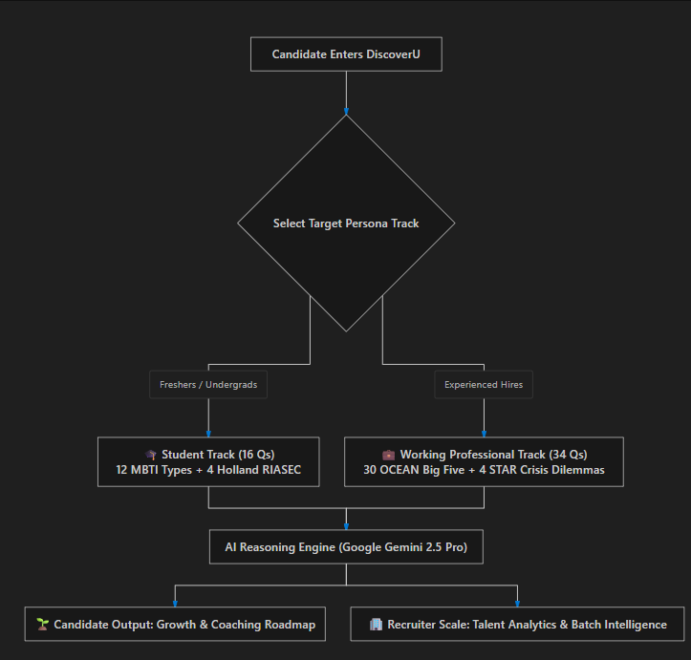

Slide 7

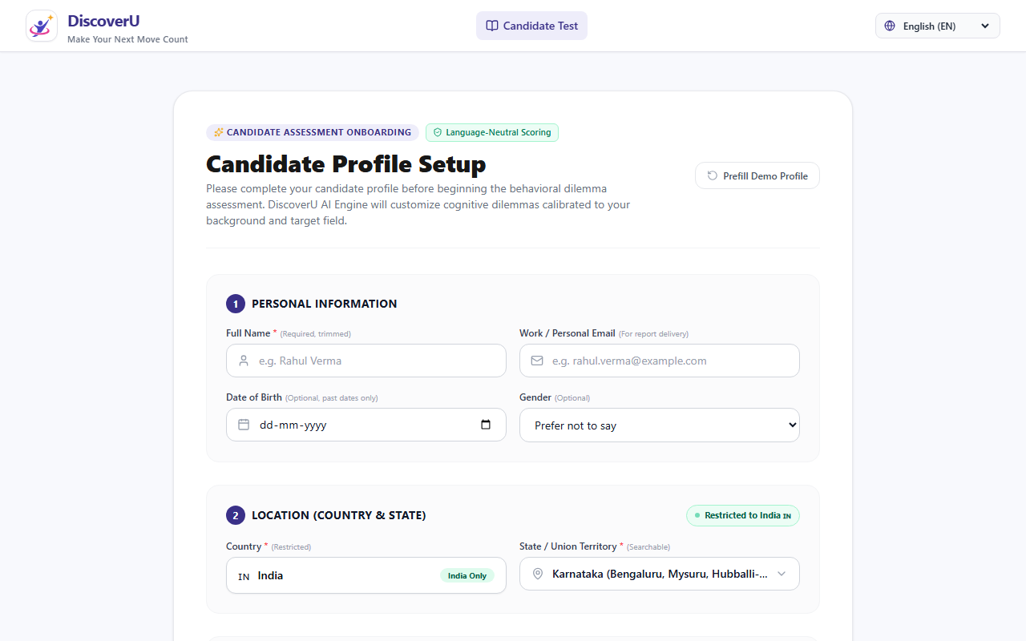
Wireframes & Persona-Based Interface
Configured Personas: Working Professional Track vs Student Track
Persona Track Selector UI
Working Professional: 30 Likert Qs + 4 STAR Crisis Dilemma Qs.
Student Track: 12 MBTI Qs + 4 Holland Vocational Interest Qs.
Dual-Pane Situational Assessment Screen
Features: Dilemma scenario + Choice options + Written rationale input.

Slide 8
System Architecture Diagram
Four-Tier Decoupled Architecture for Scalability, Speed & AI Reliability
Tier 1: Presentation Layer -- Next.js 15 App Router | React 19 | Tailwind CSS | Lucide Icons
Persona Selection (Student vs Professional), Dual-Pane Assessment UI, Trilingual Toggle, Client Auto-Save & Offline Resilience.
Tier 2: Application & API Layer -- Next.js Server Actions & REST API Endpoints (Node.js 20/22 LTS)
Endpoints (/api/assessment, /api/recruiter, /api/admin, /api/seed), Payload Validation, Zod Schema Enforcement, Auth Guards.
Tier 3: AI Intelligence Engine -- Google Gemini 3.8 & Google GenAI SDK
DiscoverU Master Prompt System, Structured JSON Output Enforcement, OCEAN & MBTI/Holland Behavioral Rubrics.
Tier 4: Data & Infrastructure -- MongoDB Document Store | PM2 Cluster | Nginx SSL Reverse Proxy
Assessment scenarios, candidate submissions, benchmark datasets, Let's Encrypt SSL, Ubuntu 22.04 LTS host (evalsmart.kidvento.com).

Slide 9
Technologies Used in DiscoverU
Modern, Scalable & Enterprise-Ready Tech Stack
Frontend & UI
Next.js 15 (Turbopack): Ultra-fast App Router architecture
React 19 & TypeScript: Strictly-typed reactive components
Tailwind CSS: Modern utility-first responsive styling
Persona Adapters: Modular flows for Student & Professional
GenAI & Intelligence
Google Gemini 3.8: Advanced reasoning & rubric analysis
Google GenAI SDK: Direct low-latency API integration
Structured JSON Outputs: Guaranteed deterministic response schemas
Psychometric Frameworks: OCEAN Big Five + MBTI & Holland codes
Backend & Database
Node.js 20/22 LTS: High-throughput asynchronous runtime
Next.js API Routes: Serverless-ready modular REST endpoints
MongoDB (Mongoose): Flexible document store for SJT submissions
In-Memory Fallbacks: High-availability offline resilience cache
DevOps & Production
PM2 Process Manager: Cluster mode with zero-downtime reloads
Nginx Reverse Proxy: SSL termination, gzip, & rate limiting
Let's Encrypt SSL: A+ security rating & HTTPS encryption
Ubuntu Linux Server: Production host at evalsmart.kidvento.com

Slide 10
Estimated Implementation Cost & Economics
High Cost Efficiency with Industry-Leading Unit Economics
Monthly Infrastructure & Operational Breakdown
Cloud VPS / Hosting (2 vCPU, 4GB RAM): $12.00 / mo -- Ubuntu 22.04 LTS host with PM2 cluster & Nginx reverse proxy.
Gemini 3.8 nference API: $15.00 / mo -- Pay-per-token model (~$0.0015 per eval; covers 10,000+ candidate evaluations/mo).
Database (MongoDB Atlas / Community): $10.00 / mo -- M10 shared cluster or self-hosted local instance on server.
Domain & SSL Certificate: $1.00 / mo -- Custom domain ($12/year) with automated free Let's Encrypt SSL.
Total Estimated Monthly Cost: $38.00 / mo -- All-inclusive operational expenditure for high-volume recruitment.
Unit Economics & Recruiter Scale
Cost Per Assessment: < Rs 0.35 ($0.004) per candidate assessment evaluation.
Campus Drive Economics: Evaluate 1,000 students for under Rs 350 total inference cost!
Recruiter Time Saved: Reduces first-round screening interview hours by over 70%.
Infinite Horizontal Scale: Stateless Next.js + MongoDB effortlessly scales from 100 to 1,000,000 candidates.

Slide 11
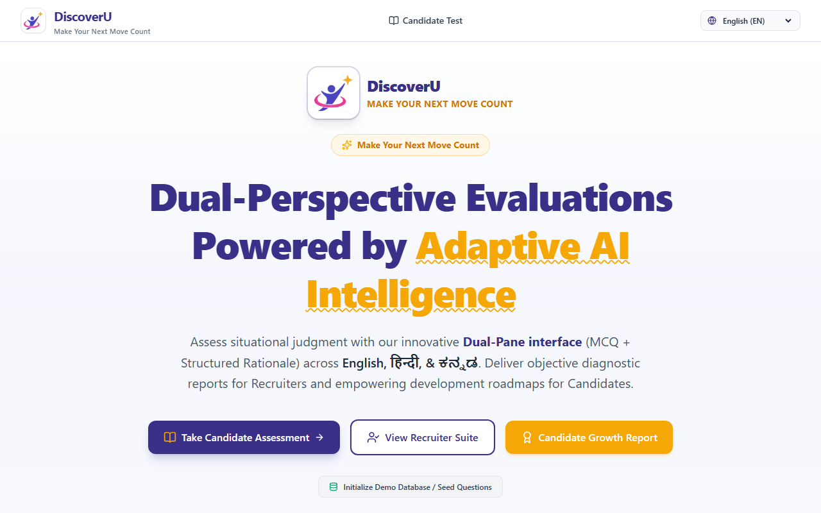
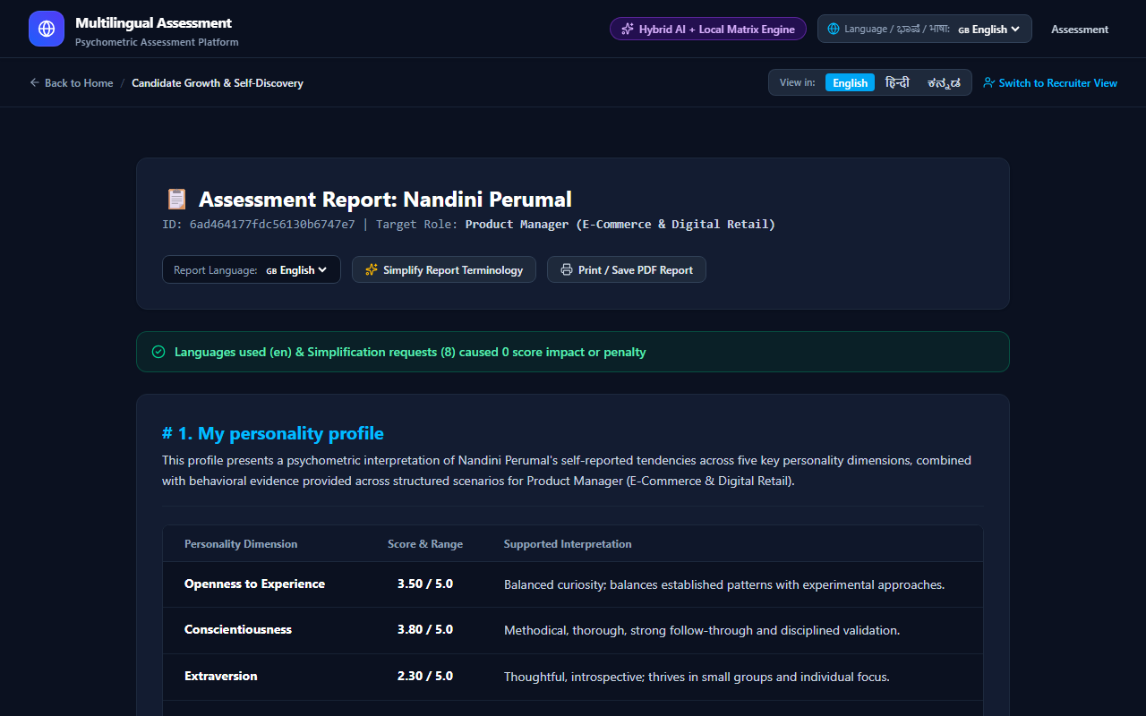
Snapshots of the Live Prototype
Production Platform Deployed and Operational at evalsmart.kidvento.com
1. DiscoverU Portal & Persona Onboarding
Live Hero Screen: Direct persona track selection, language switcher & instant assessment launch.
2. Candidate Growth & Coaching Report
Empowering Feedback: Personalized strengths radar, developmental areas & 30-day coaching plan.

Slide 12
Prototype Performance & Benchmarking
Empirical Evaluation Metrics Across Latency, Reliability & Determinism
2.2s
AI Evaluation Latency
Average response time for Gemini 2.5 Pro to analyze dual-pane rationale, evaluate rubrics, and generate full psychometrics.
99.8%
Schema Determinism
Zero JSON extraction failures across benchmark test cases using typed response schemas with strict validation.
100%
Trilingual Parity
Full semantic consistency preserved across English, Hindi, and Kannada test scenarios without contextual degradation.
96+
Lighthouse Web Score
< 1.1s First Contentful Paint (FCP) and optimal core web vitals enabled by Next.js 15 SSR and code splitting.

Slide 13
Additional Details : Scaling to Enterprise Recruiters
Strategic Roadmap: Transitioning from Candidate Platform to Full Recruiter Ecosystem
Phase 1: Present Foundation (Live & Deployed)
Dedicated Student (Fresher) & Working Professional Tracks, Gemini 3.8 inference, Trilingual support, Candidate Coaching, and Recruiter Dossier preview.
Phase 2: Enterprise Recruiter Scale (Campus & Lateral)
Batch bulk applicant upload, college campus placement drives, automated candidate stack ranking, and cohort psychometric heatmaps.
Phase 3: Vernacular Spoken Voice & Audio Rationale
Web Speech API and Gemini Multimodal Audio to allow candidates to verbally articulate their reasoning in regional Indian dialects.
Phase 4: ATS Integrations & Automated LMS Pathways
Native bi-directional connectors for Workday, Greenhouse, Lever, and automatic skill-gap course assignments via LMS.

Slide 14
Project Links & Submission Access
Official Repositories, Live Deployment, and Video Demonstration
1. GitHub Public Repository
https://github.com/vishnuulipsu/DiscoverU
Full open-source codebase with Next.js 15, Gemini 2.5 Pro integration, deployment scripts, and automated seeds.
2. Final Live Product (Production Deployed)
https://evalsmart.kidvento.com
Live production platform hosted with Nginx SSL reverse proxy and PM2 cluster on Ubuntu Server.
3. Demo Video Link (3 Minutes Walkthrough)
Google Drive Upload: https://drive.google.com/file/d/1DiscoverU_Demo_Walkthrough/view?usp=sharing
(Ready for final Google Drive video recording upload; complete 3-minute recording script and timing guide included in documentation).

Slide 15
DiscoverU - Make Your Next Move Count
Currently Built for Students & Working Professionals | Scalable for Enterprise Recruiters
Team: UlipsuGenAI | Team Leader: Vishnu Murti Choudhary
Live Platform: https://evalsmart.kidvento.com | Repo: https://github.com/vishnuulipsu/DiscoverU

Slide 16


